Slide 1
B-Tech Presentation
Using Cloud Top temperature for forecast of Cyclone track using Machine learning approach.
Name-Vrishabh Kenkre
Roll no.-19ME01009
Branch-Mechanical
Project Guide-Dr. Srinivasa Ramanujan Kannan

Slide 2
Contents
Introduction
Problem Statement
Objectives
Methodology
Progress till Now
Timeline

Slide 3
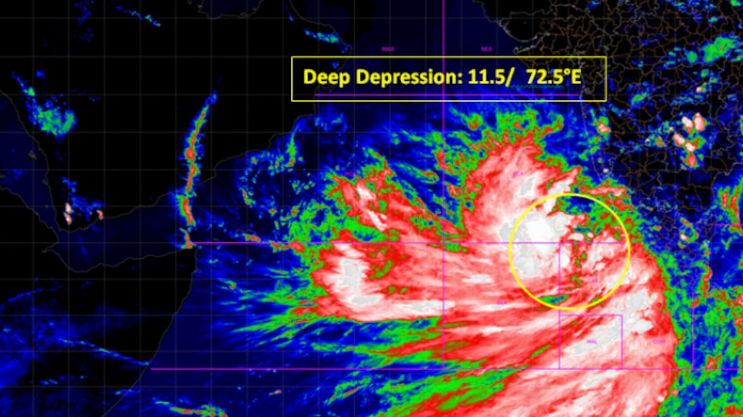
Introduction
Tropical cyclone forecasting is the science of forecasting where a tropical cyclone's center, and its effects, are expected to be at some point in the future.
One reason for the importance is the potential damage and loss of life which can occur with the passage of an intense tropical cyclone.
https://www.indiatoday.in/india/story/cyclone-cyclonic-storm-tauktae-arabian-sea-india-kerala-gujarat-lakshwadeep-goa-rainfall-imd-1802685-2021-05-14

Slide 4
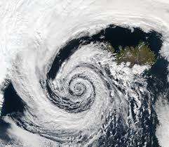
Introduction
We can forecast a cyclone 1-2 days before its arrival with sufficient accuracy with pressure as a parameter.
We can’t predict it early on as accuracy drops drastically every 24 hours.
Low pressure zones(Depressions) are formed during a cyclone.
https://en.wikipedia.org/wiki/Cyclone

Slide 5
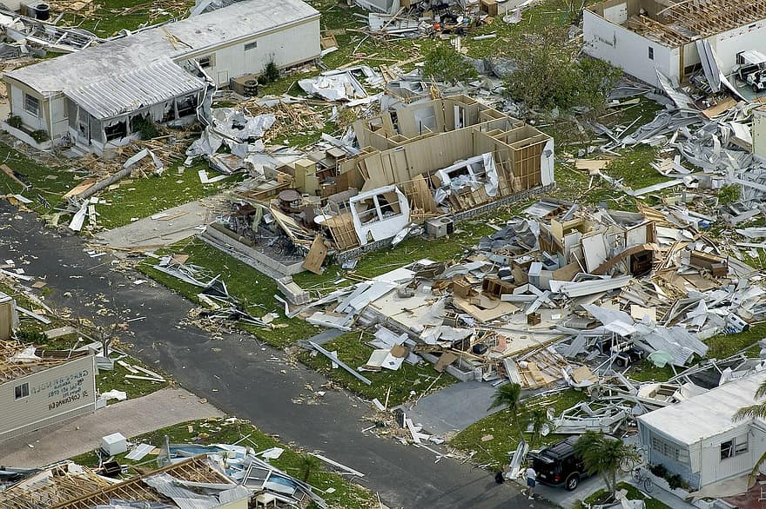
Problem statement
Cyclones incur massive loss of human resources and economic deprivation.
Forecast of such a weather condition play a crucial role in determining the occurrence of cyclone.
Delayed forecasting can be attributed to the various dynamics of each cyclone and its genesis.
https://timesofindia.indiatimes.com/city/kolkata/seven-killed-as-cyclone-bulbul-disrupts-normal-life-in-west-bengal/articleshow/71993384.cms

Slide 6
Objectives
Get to know the pattern from ITS matrix.(Shrinking/scattered,etc).
Use Machine learning to extract features and compare it.
Expected outcome is a model that when fed with CTT data, should predict occurrence of cyclone 7-14 days prior to its arrival.
It should inform the occurrence of cyclone with good accuracy.

Slide 7
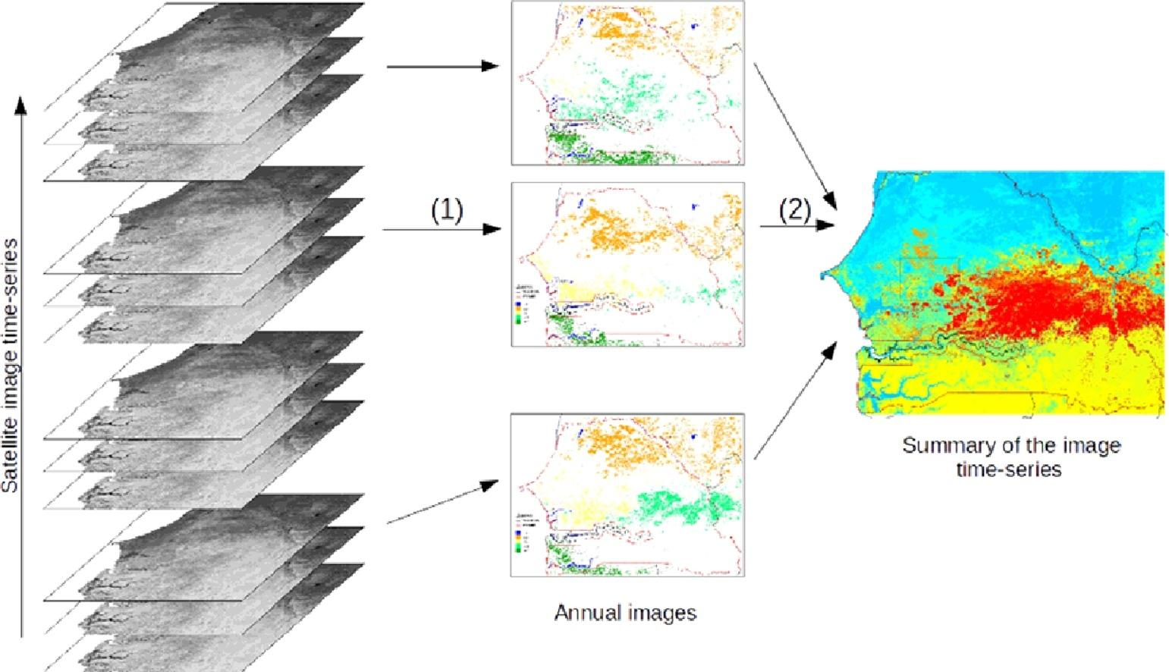
Methodology
Order and download data(Satellite Images in regular time interval) from Meteorological and Oceanographic Satellite Data Archival centre(MOSDAC).
Take series of Cloud top Temperature in time domain.
Convert the data file(.hdf5) to 2D array in MATLAB. Now we 3D data cube(2D +t) as Satellite Image time series(SITS).
Convert the ITS into 2D by reducing spatial domain to 1D. Sort it according to the desired parameters.
https://www.sciencedirect.com/science/article/pii/S0167865515003918

Slide 8
Methodology
Check for a pattern in the ITS for given parameters.
Find some common features in the pattern. Examine if the features are present in any past data of additional ITS.
Inspect if these features lead to formation of Cyclone or not.
Reevaluate all features and build a model that can predict accurately or with good probability the occurrence of cyclone 14 days prior to its arrival.

Slide 9
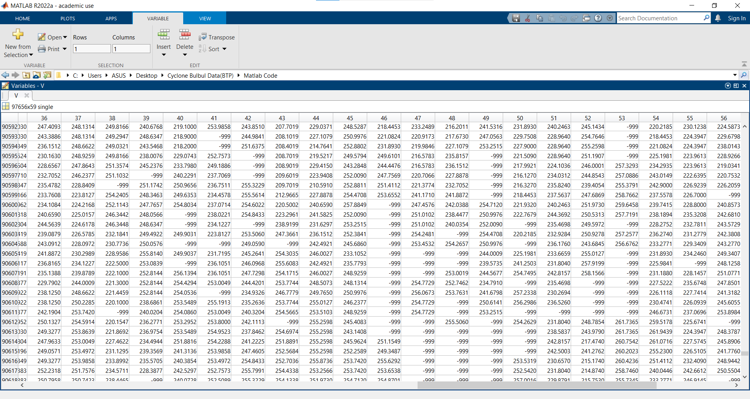
Progress till now
Ordered data from MOSDAC on Cloud top properties.
MATLAB code for extracting info from .hdf5 file data every 6 hours , 14 days prior to arrival of cyclone Bulbul.(from 22nd Oct to 5 Nov).
Converting 2D+t ITS into 1D+t series.

Slide 10
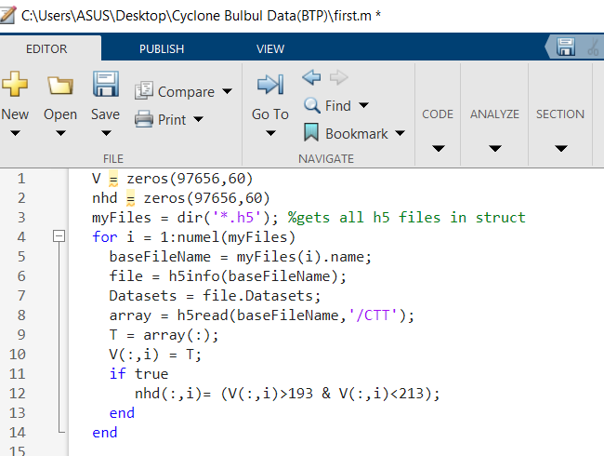
Progress till now
Selecting temperatures between 193K and 213K(-80C to -60C).
Making a binary array by denoting the temperatures in above range by one and other by zero.
Calculating no. of 1’s in every column and their positions. Comparing it across the time domain.
Finding pattern by feeding this matrix into neural network toolbox.

Slide 11
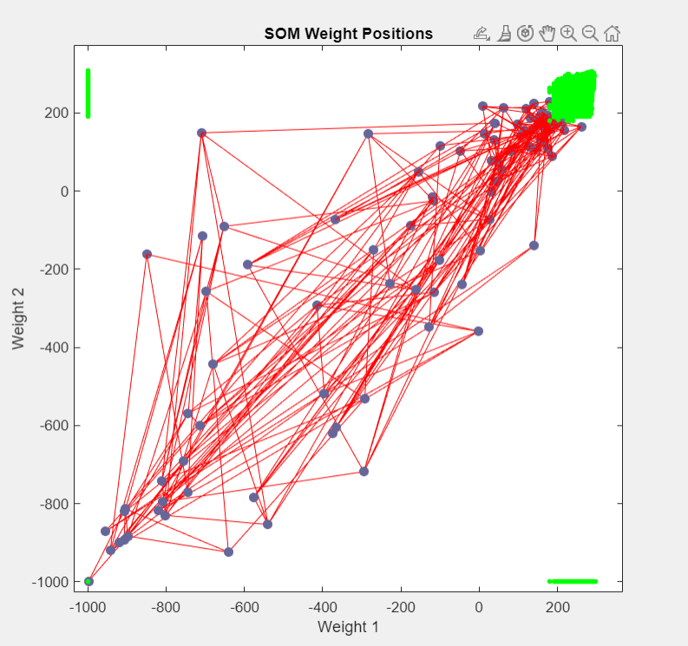
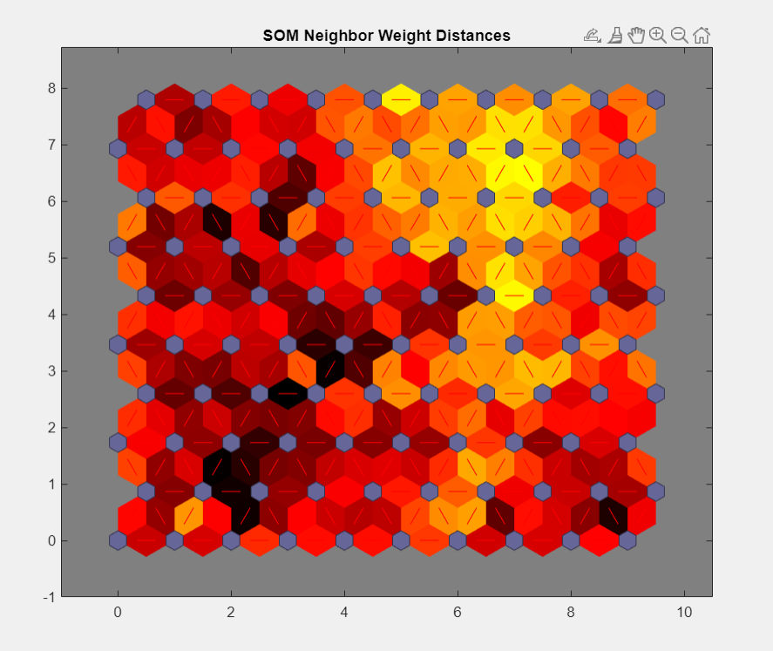
Results

Slide 12
Timeline
Aug 27-Dec
Order and download data
Make a ITS matrix
Recognize pattern in it using different apps in matlab.
Write MATLAB code to read file info.
Aug 20-22
Aug 22-23
Aug 24-26
Optimize and finish the model.
Yes, then prepare a model and test its probability.
Check if similar features result in formation of cyclone
Feed it to machine learning tool boxes to find its features.
Mar-May
Feb-Mar
Jan-Feb
May-May

Slide 13
THANK YOU

